Slide 1
Presenting with authority
How to present yourself and your data with confidence
@zoe_on_the_go #busiscc20

Slide 2
Who Am I?

Slide 3
Building your presence
Building your brand; being ‘visible’
Getting yourself out there: both physically and virtually.
Online - LinkedIn; Blogs; Social Media etc.
Physically - Networking events; conferences etc.

Slide 4
Why does having a ‘brand’ matter?
It will help you get known; people will be associate you with the things you talk about etc.
You want to focus on what you’re good at and be able to ‘sell’ it.
People will resonate with you more if you’re open about who you are and appear authentic.
Being able to recognise what messages work best on which channels will help your messages land better.

Slide 5
Tips for presenting well
Do:
Speak slowly and clearly and be personable, eye contact is still important.
Consider your audience, and how to best connect with them.
Use a mix of words and images. Not everyone engages in the same way.
Keep it simple, and relevant, less is more.
Find your own style.
Notes:
Everyone has their own style. Don’t just copy someone else, what works for them might not work for you.
Some people need to do multiple run throughs before a presentation. Some memorise pages of notes, or have lots of speakers notes on their screen. Some do better ‘winging it’ with minimal preparation. Find what works for you.

Slide 6
Tips for presenting yourself well (cont)
Don’t:
Use exactly the same presentation or report for different audiences
Do an hour long talk full of 100 slides; each with 1000 words and no pictures on.
Use complex data for the sake of it, or throw lots of data at your audience; make sure anything you are sharing is relevant and easy to interpret correctly.
Notes:
We’ve all see the daily COVID-19 briefings, basically, don’t do that.

Slide 7
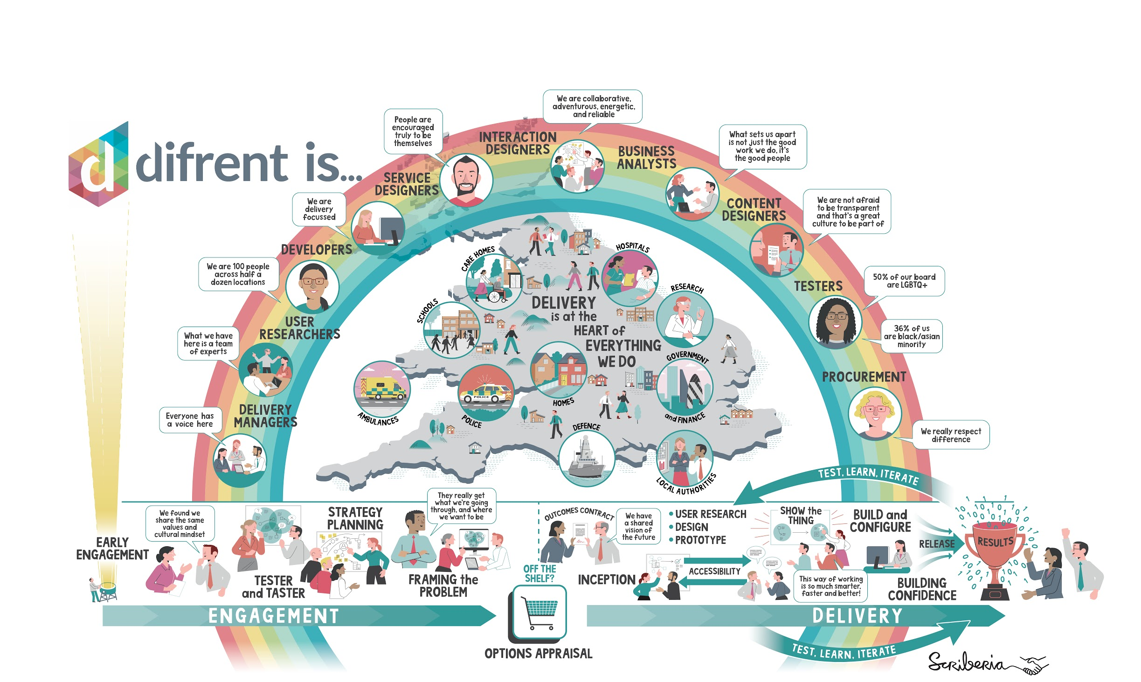
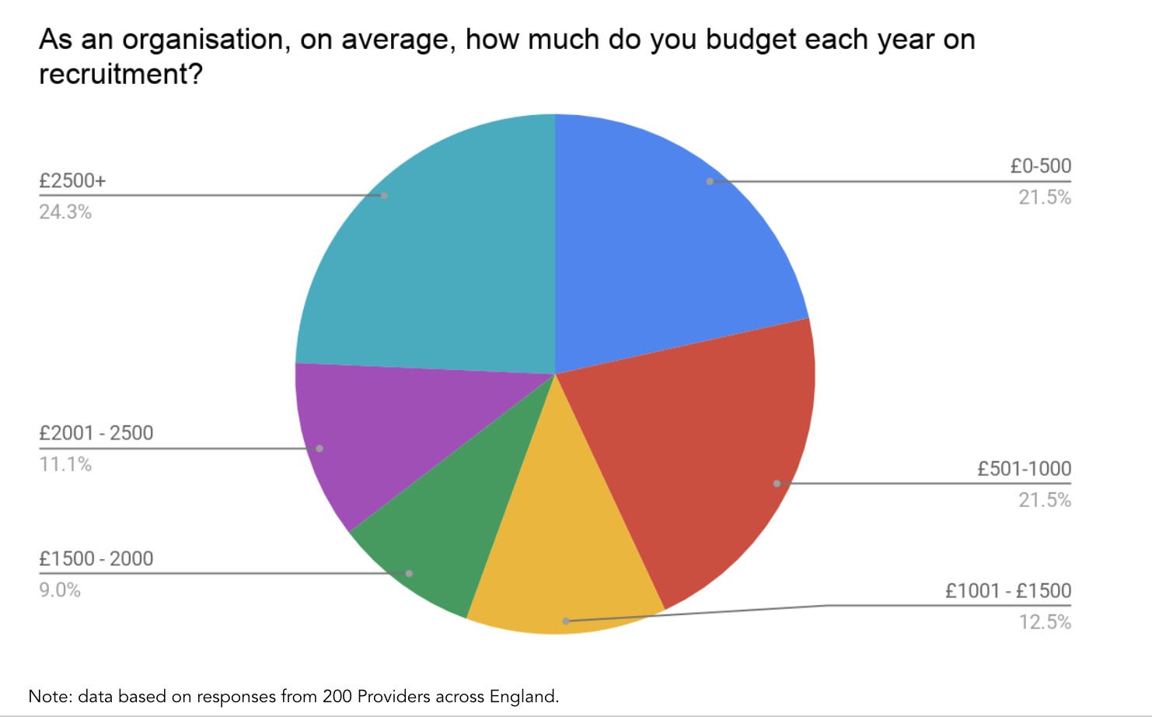
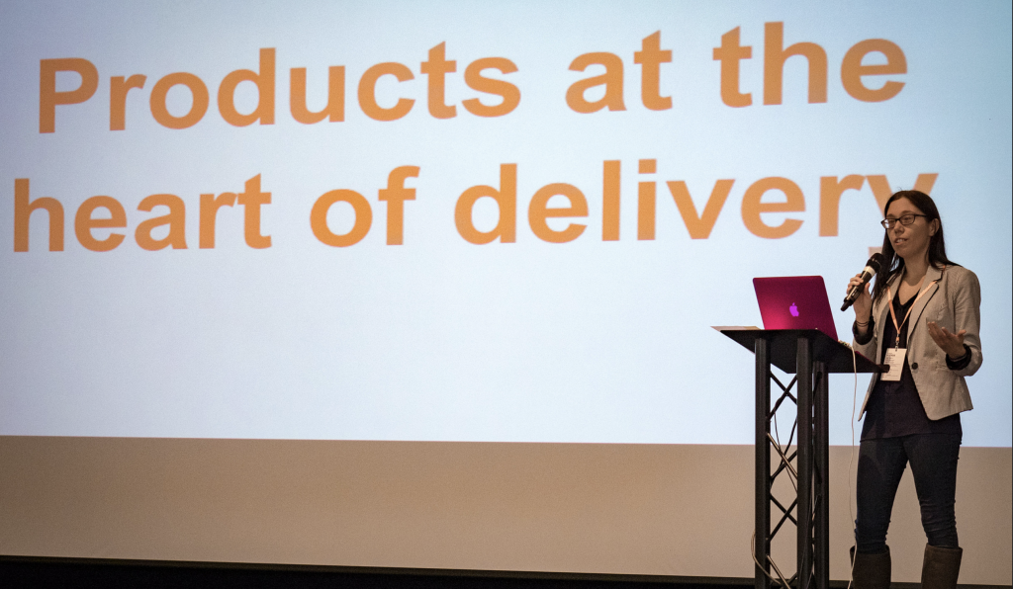
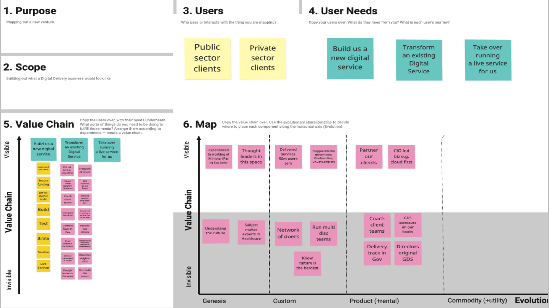
Different ways to tell your story
High-level figures
Sector-wide churn rate | 440,000 | jobs per anum
Total potential cost | £1,602,480,000.00 | of churn
Total potential savings % | Value of savings
10% | £20,636,000.00
25% | £51,590,000.00
50% | £103,180,000.00
75% | £154,770,000.00

Slide 8
Why use data to help to sell yourself?
There are lots of reasons we use data; we use it to:
To monitor delivery against targets and understand if we’re achieving our goals
To identify any trends and analyse what is or isn’t working how we expected
To understand any gaps or options that we could target
To make recommendations on improvements we could make
Put it simply we use it to build understanding and confidence, both our own and others

Slide 9
What is data?
Quantitative - data that is easy to quantify or count.
It’s always numerical.
It’s structured.
Metrics
Analytics
Key Performance Indicators
Qualitative - data that cannot be counted, measured or easily expressed using numbers
It’s not numerical.
It’s unstructured.
Ethnographic (This is data about a group) Focus Groups etc; surveys etc.
Interpretive (This is data about an Individual) Interviews, participant observation etc.

Slide 10
Surely we just need to use the numbers?
Adult social care jobs in numbers
18,500 care organisations, predominantly small and private sector, in England
1.49 million people work in ASC in England
122,000 vacancies (7.8% vacancy rate)
59% of all jobs are in a private establishment
£
£2,230 - cost of training each employee (The Wolverhampton Position 2016)
1.21 staff starting for every 1 that leaves the industry (The Wolverhampton Position 2016)
83% of people would continue working in the sector
Only 1 in 25 people considering a job in ASC go on to apply
No Mi / Bi available from a single accurate source

Slide 11
Knowing what data to use and when
Quantitative data can be easy to analyse and help people understand things.
Using qualitative data in reporting helps make it more relevant/ personal and can add useful narrative.
You don’t always need both, but it can definitely help.
When choosing what kind of data to use the things to consider are:
Who is your audience?
What are you trying to achieve?
Have you got a wide enough sample?
How are you going to present the data?

Slide 12
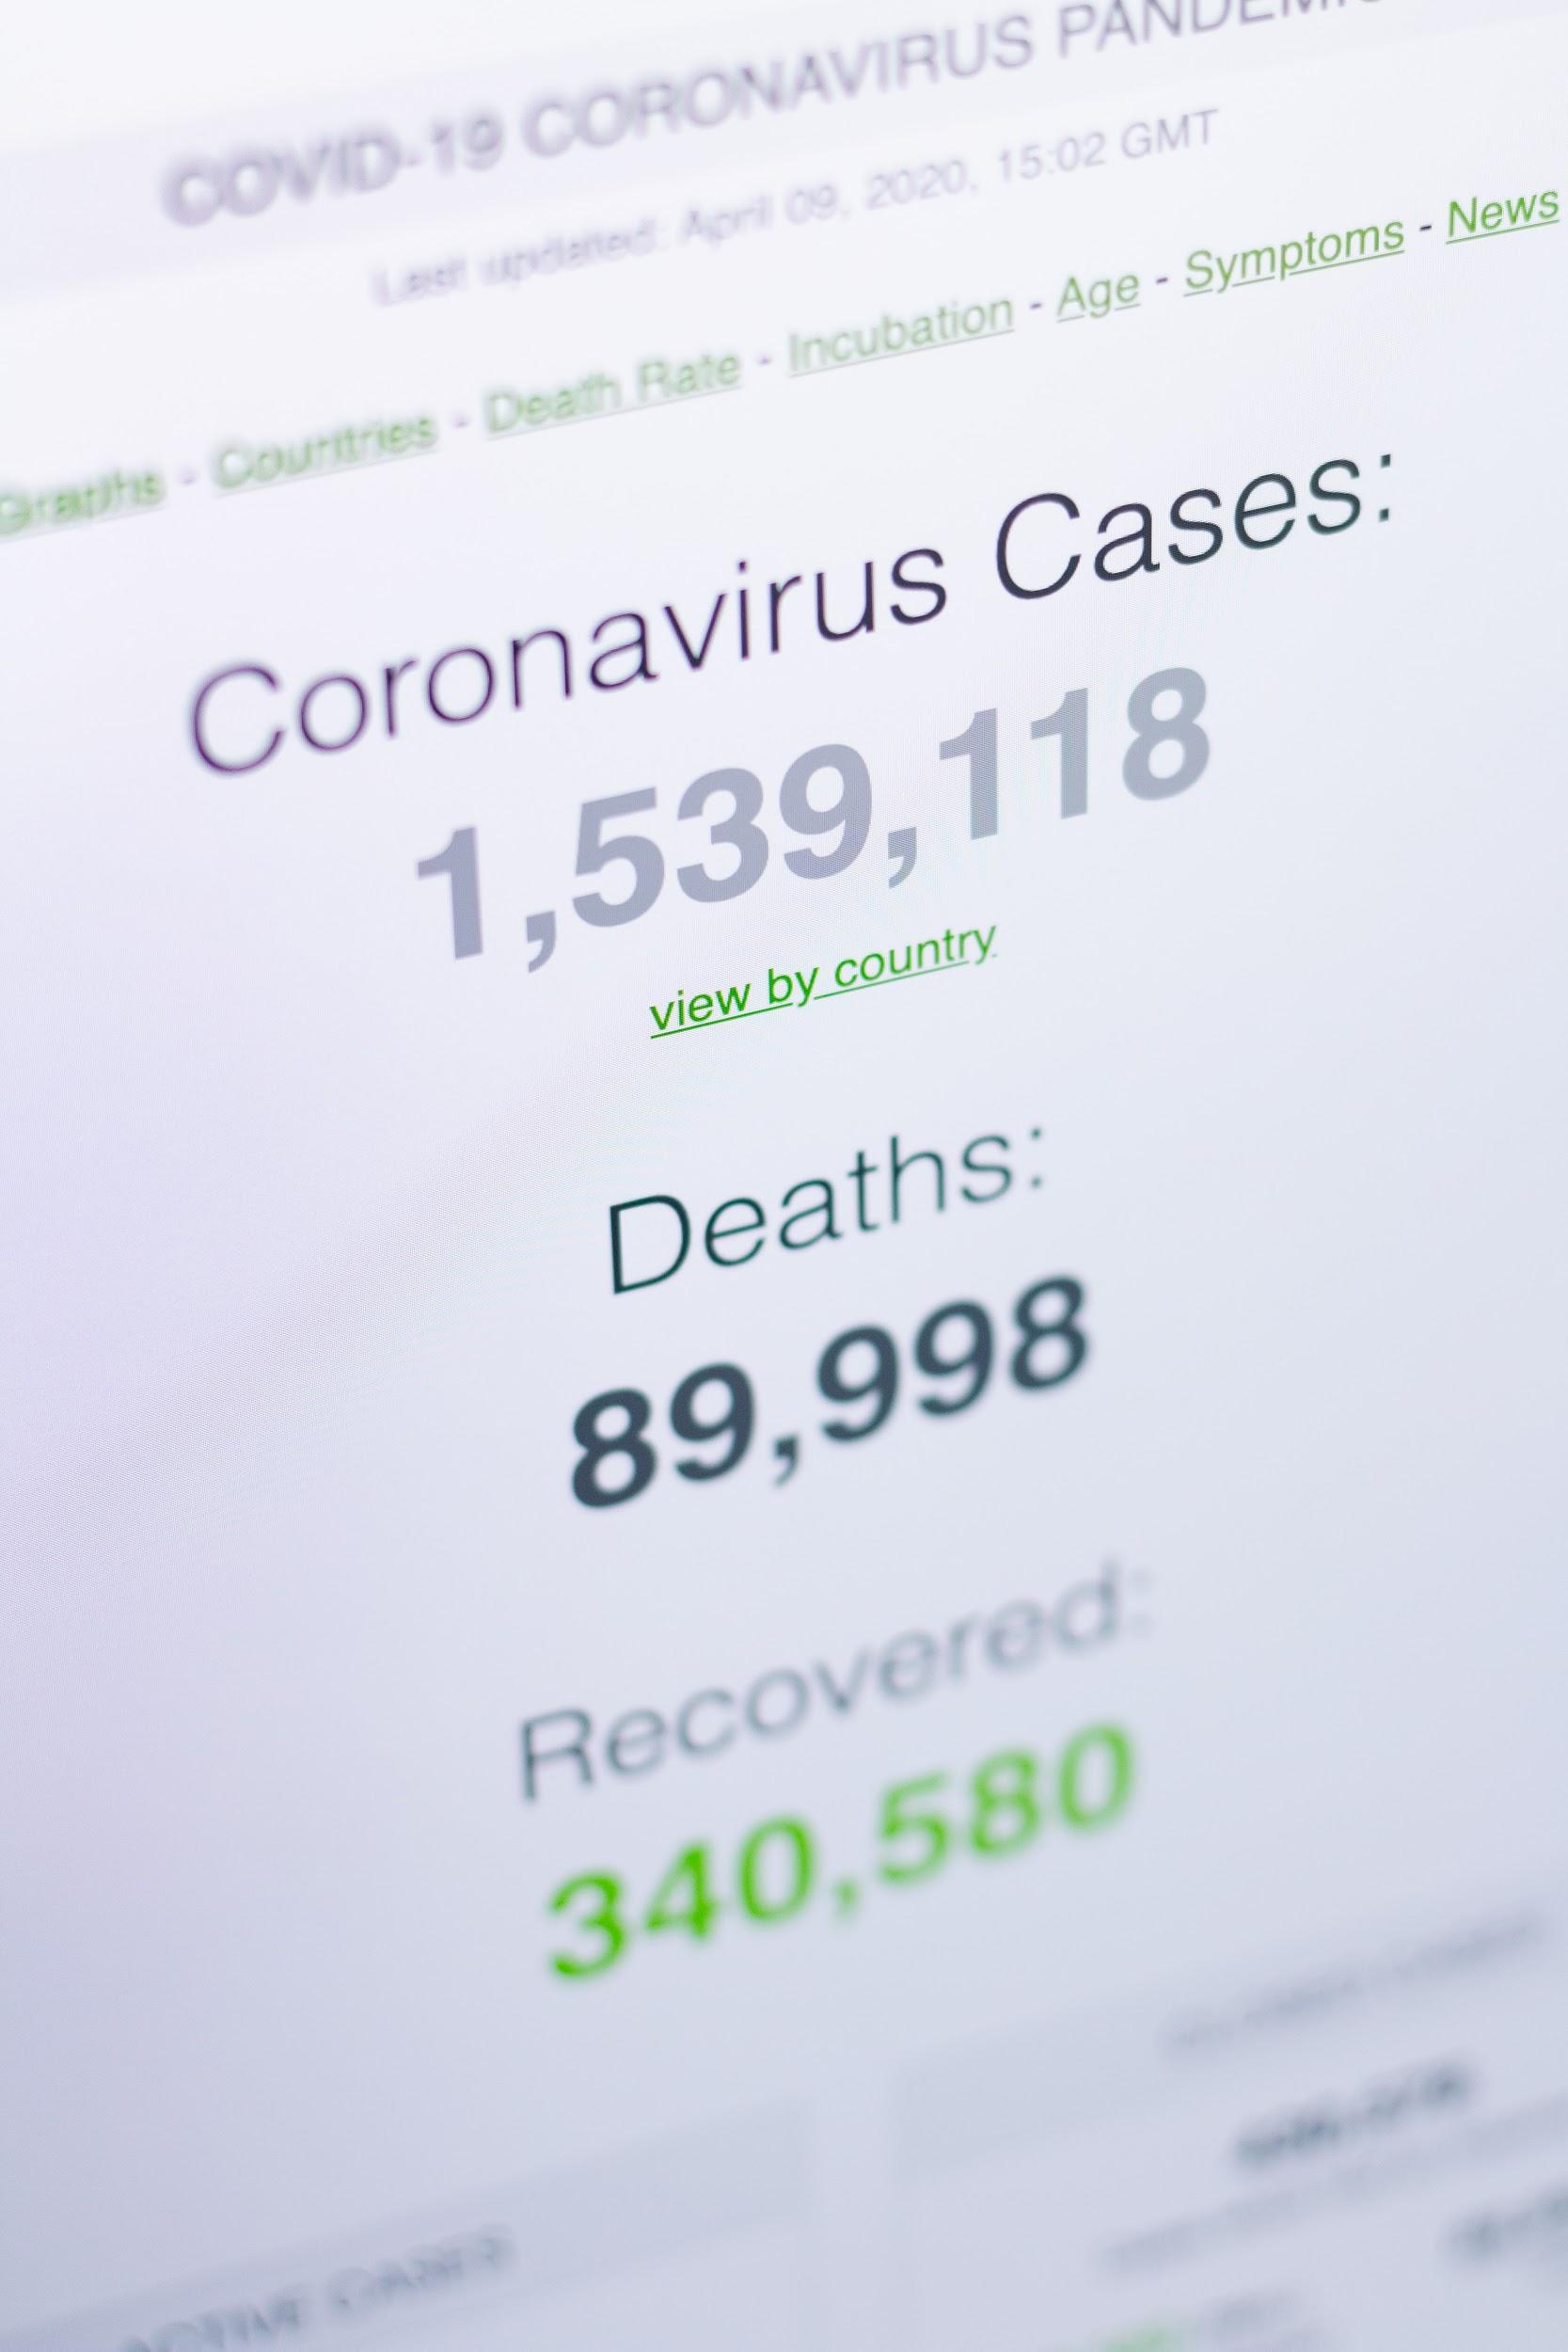
How to present data well:
Remember numbers on their own mean nothing, context is everything.
Focus on the output you are trying to achieve, and how you will measure success.
Make sure when gathering your data your sample size is inclusive.
When presenting data, make sure you consider accessibility etc.
Keep the data simple, don’t visualise it for the sake of it.
If using data, make sure it’s anonymised.

Slide 13
Some people who know how to present well:

Slide 14
Questions?
@zoe_on_the_go #busiscc20

Slide 15
Some things you can watch at home
The Speech that Made Obama President
https://www.youtube.com/watch?v=OFPwDe22CoY
Dave Gorman's Modern Life is Goodish
https://t.co/mCFMuhrMz3?amp=1
Human-Centered Data Transformation – Kit Collingwood https://www.youtube.com/watch?v=I49wV6IsDAs
Sheryl Sandberg, COO of Facebook, on Using Your Voice For Good https://www.youtube.com/watch?v=YZXUcYGprDY
PRESENTING AND PUBLIC SPEAKING TIPS -
https://www.youtube.com/watch?v=Q5WT2vweFRY

